Slide 1
Week 5
Turing Reducibility
And some nice theorems and concepts

Slide 2
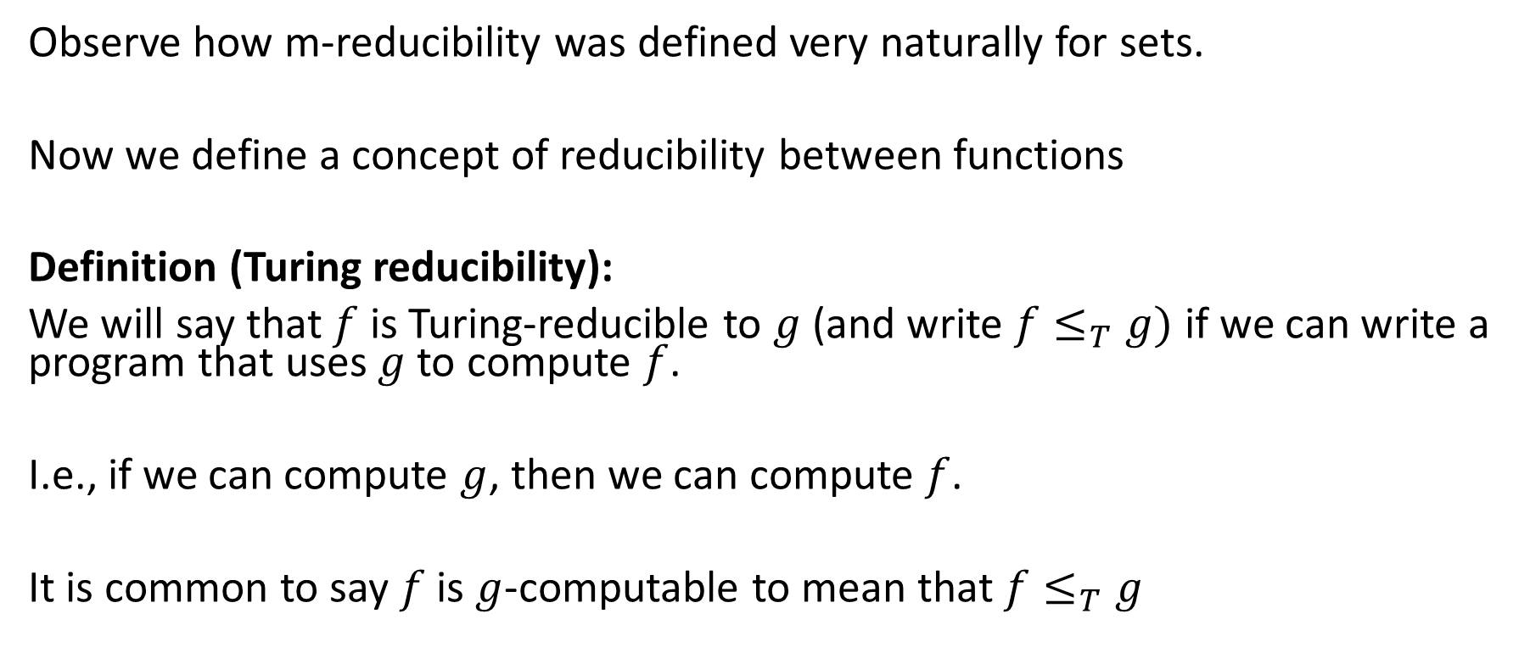

Turing Reducibility (denoted $≤_{T}$)
Observe how m-reducibility was defined very naturally for sets.
Now we define a concept of reducibility between functions
Definition (Turing reducibility):
We will say that $f$ is Turing-reducible to $g$ (and write $f≤_{T}g)$ if we can write a program that uses $g$to compute $f$.
I.e., if we can compute $g$, then we can compute $f$.
It is common to say $f$ is $g$-computable to mean that $f≤_{T}g$

Slide 3

Turing Reducibility for sets
For sets, we write $A≤_{T}B$ to mean that $I_{A}≤_{T}I_{B}$.
We also say $A$ is $B$-decidable (if $B$ is decidable, then “$B$-decidable” is the same as just “decidable”).

Slide 4
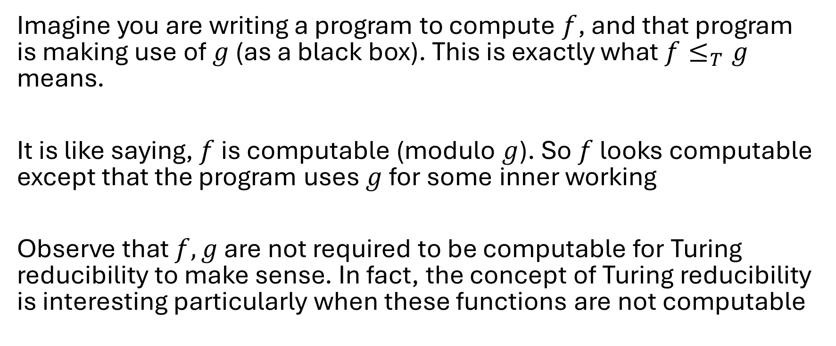
Intuition for Turing reducibiliby
Imagine you are writing a program to compute $f$, and that program is making use of $g$ (as a black box). This is exactly what $f≤_{T}g$ means.
It is like saying, $f$ is computable (modulo $g$). So $f$ looks computable except that the program uses $g$ for some inner working
Observe that $f,g$ are not required to be computable for Turing reducibility to make sense. In fact, the concept of Turing reducibility is interesting particularly when these functions are not computable

Slide 5

Activity 1
Prove that $\overline{K}≤_{T}K$ but not $\overline{K}≤_{m}K$. $Recall K=\{e:M_{e}(e)↓\}$
Proof:
Hint: $I_{\overline{K}}\left(x\right)=1−I_{K}(x)$
def $I_{\overline{K}}\left(x\right):$
u = $I_{K}(x)$
return 1 – u
By CT, $\overline{K}≤_{T}K$
In this example, we call $K$ the oracle

Slide 6
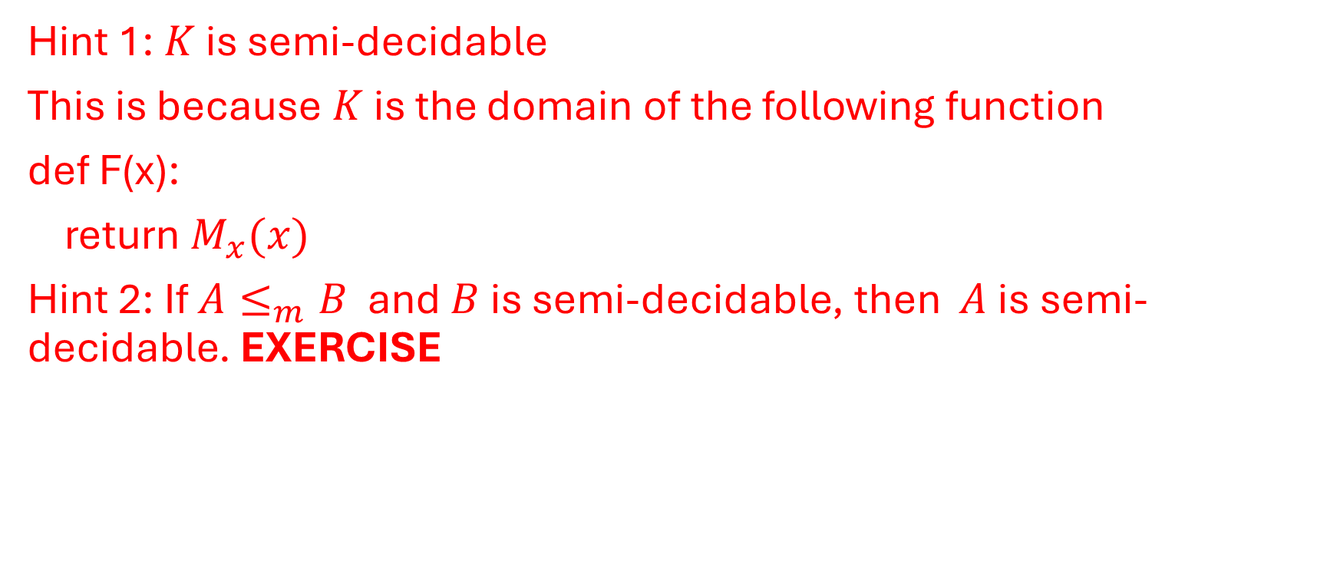
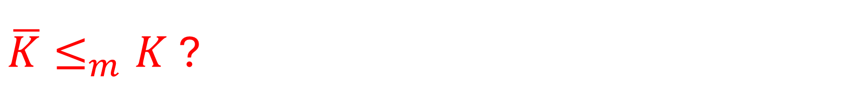
$\overline{K}≤_{m}K$?
Hint 1: $K$ is semi-decidable
This is because $K$ is the domain of the following function
def F(x):
return $M_{x}(x)$
Hint 2: If $A≤_{m}B$ and $B$ is semi-decidable, then $A$ is semi-decidable. EXERCISE

Slide 7
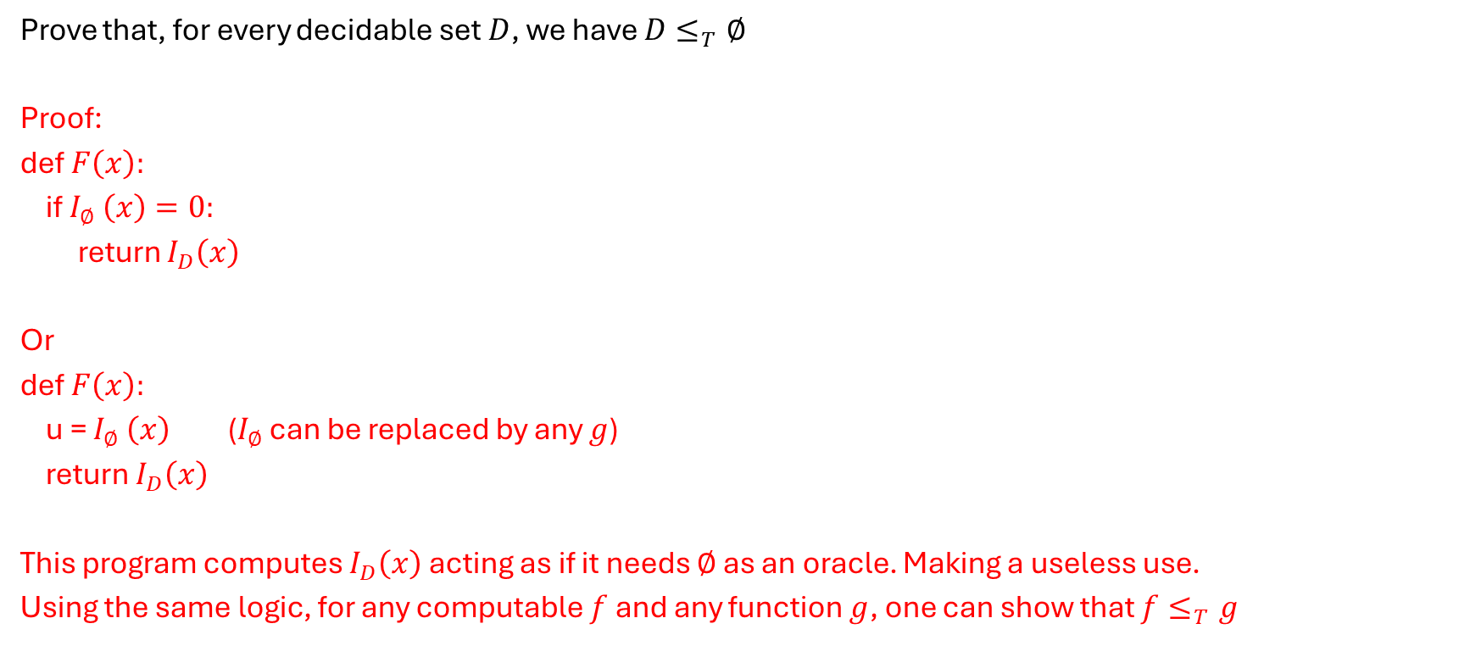
Activity 2
Prove that, for every decidable set $D$, we have $D≤_{T}∅$
Proof:
def $F\left(x\right):$
if $I_{∅ }\left(x\right)=0:$
return $I_{D}\left(x\right)$
Or
def $F\left(x\right):$
u = $I_{∅ }\left(x\right)$ ($I_{∅ }$can be replaced by any $g$)
return $I_{D}\left(x\right)$
This program computes $I_{D}\left(x\right)$ acting as if it needs $∅$ as an oracle. Making a useless use.
Using the same logic, for any computable $f$ and any function $g$, one can show that $f≤_{T}g$

Slide 8

Remark (think about it)
For any two sets $A, B$we have that
$$A≤_{1}B⟹A≤_{m}B⟹A≤_{T}B$$
$$A≤_{m}B⟹A≤_{T}B$$
Suppose $A≤_{m}B$ via $f$ (computable)
Hint: $I_{A}\left(x\right)=I_{B}\left(f(x)\right)$
def $I_{A}\left(x\right):$
#make use of $I_{B}$ ($B$as an oracle)
u = $f(x)$
if $I_{B}\left(u\right)=1:$
return 1
else:
return 0

Slide 9
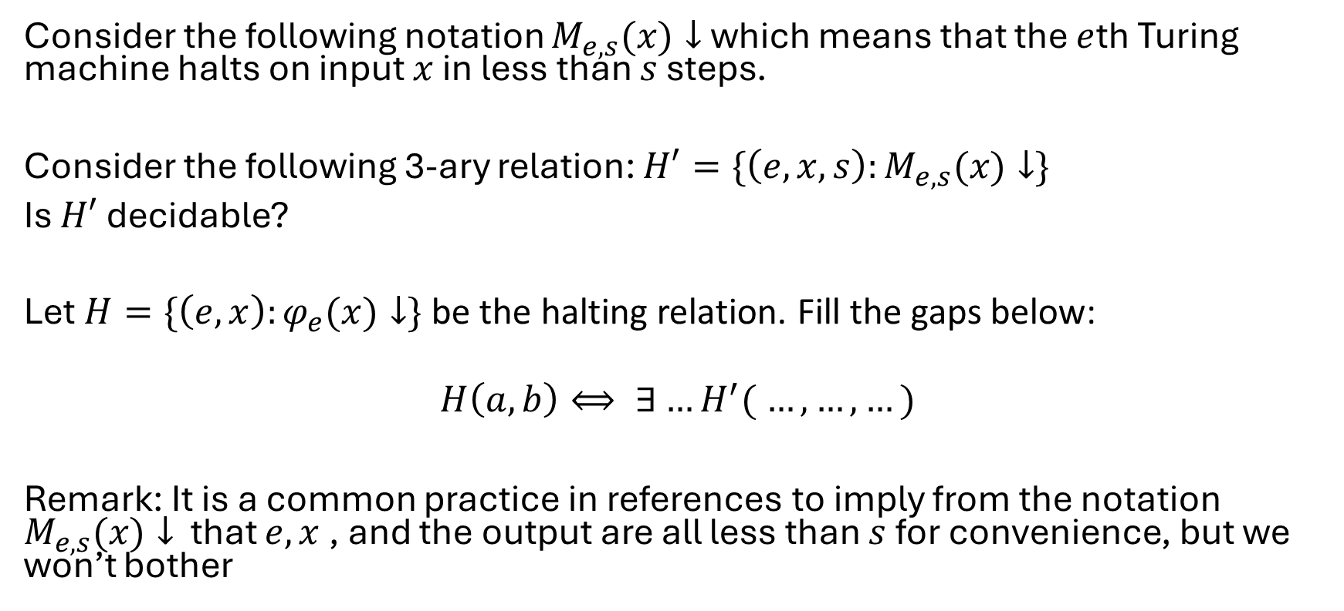

Activity 3
Consider the following notation $M_{e,s}(x)↓$ which means that the $e$th Turing machine halts on input $x$ in less than $s$ steps.
Consider the following 3-ary relation: $H′=\{\left(e,x,s\right):M_{e,s}(x)↓\}$
Is $H′$ decidable?
Let $H=\{\left(e,x\right):φ_{e}(x)↓\}$ be the halting relation. Fill the gaps below:
$$H\left(a,b\right)⟺ ∃…H^{′}( …, …, …)$$
Remark: It is a common practice in references to imply from the notation $M_{e,s}(x)↓$ that $e,x$, and the output are all less than $s$for convenience, but we won’t bother

Slide 10
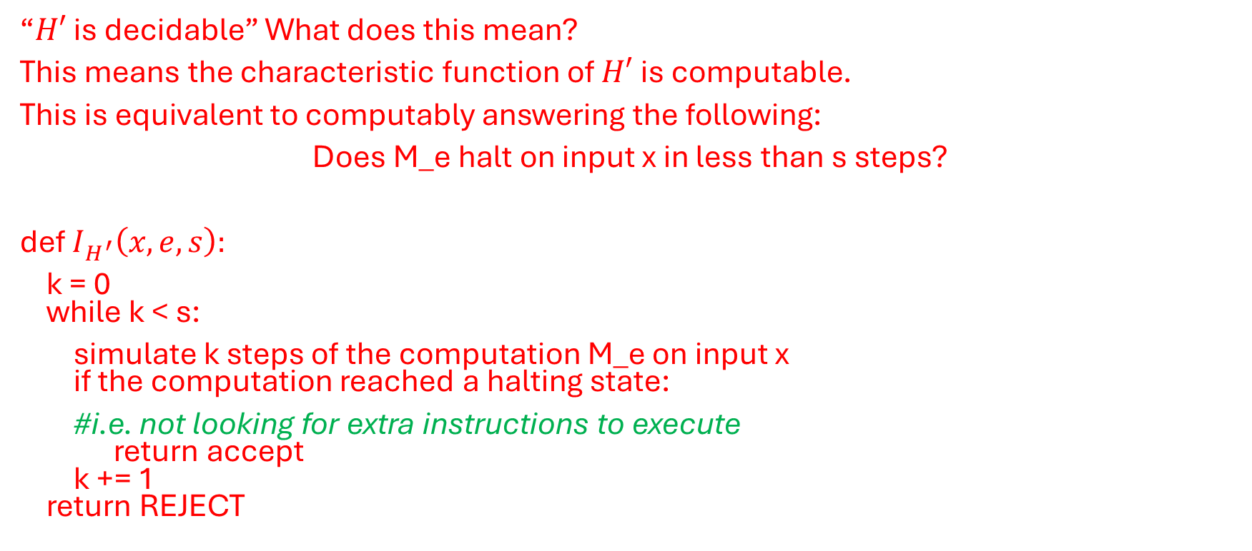
Activity 3 Remarks
“$H′$ is decidable” What does this mean?
This means the characteristic function of $H′$ is computable.
This is equivalent to computably answering the following:
Does M_e halt on input x in less than s steps?
def $I_{H^{′}}\left(x,e,s\right):$
k = 0 while k < s:
simulate k steps of the computation M_e on input x if the computation reached a halting state:
#i.e. not looking for extra instructions to execute return accept k += 1 return REJECT

Slide 11

Activity 4
Claim: For an arbitrary natural number $n$, the following set is infinite
$$\left\{e : M_{e}=M_{n}\right\}$$
$$\left\{e : φ_{e}=φ_{n}\right\}$$
True
Notes:
Known as the padding lemma

Slide 12
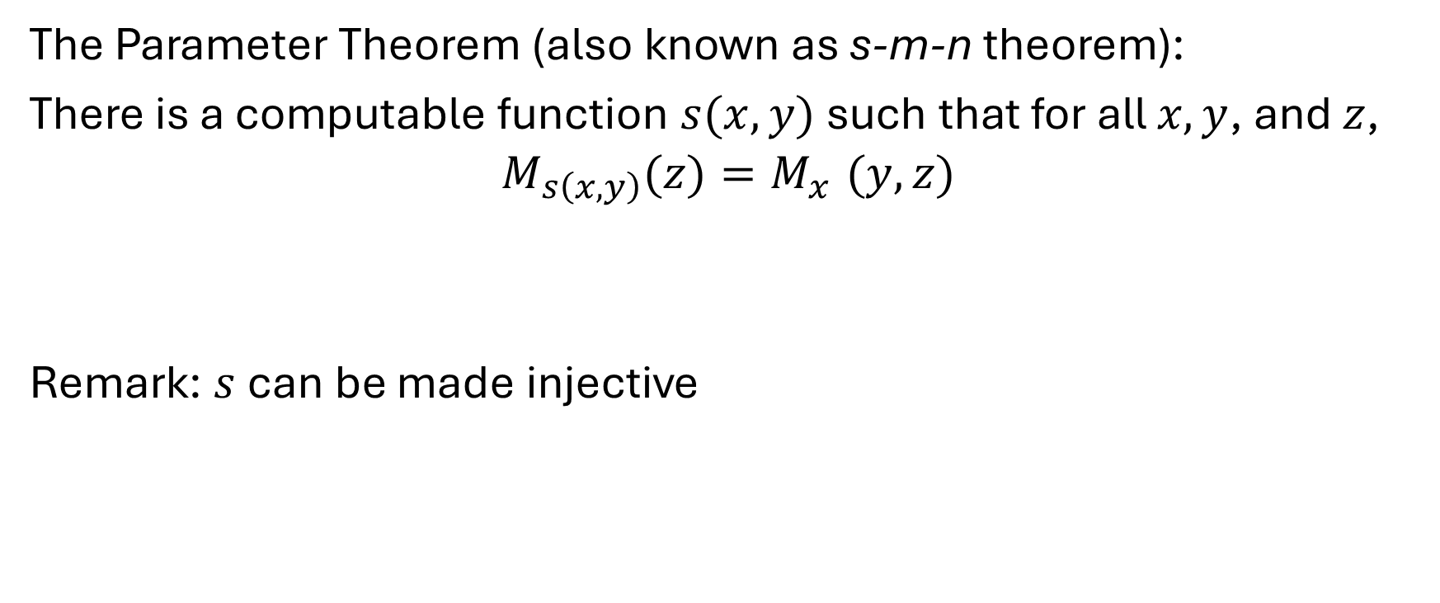
Activity 5
The Parameter Theorem (also known as s-m-n theorem):
There is a computable function $s(x,y)$such that for all $x,y$, and $z$,
$$M_{s\left(x,y\right)}(z)=M_{x}^{}(y,z)$$
Remark: $s$can be made injective
Notes:
It is like hard-coding one input as a part of the program

Slide 13
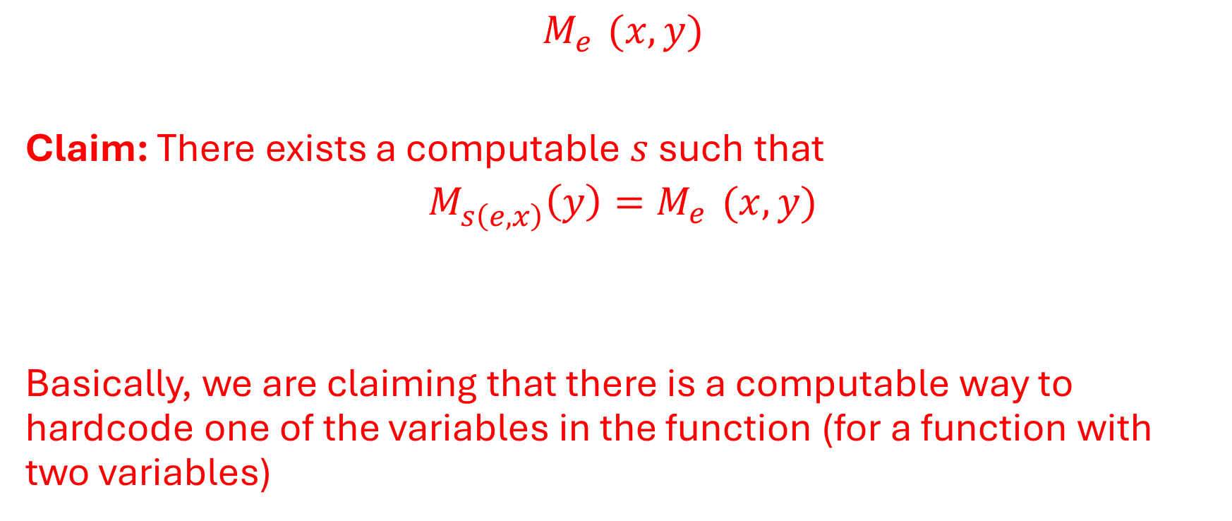
$$M_{e}^{}(x,y)$$
Claim: There exists a computable $s$ such that
$$M_{s\left(e,x\right)}^{}\left(y\right)=M_{e}^{}(x,y)$$
Basically, we are claiming that there is a computable way to hardcode one of the variables in the function (for a function with two variables)

Slide 14
Say we have a computable function G(x,y)
From that function, for every fixed x (arbitrary), using a straightforward procedure, we can compute it as a univariate function H(y) (but obviously, if x changes, H changes, this is why we write it as H_x)
Now if we involve indices, say G = M_e
Then we know the corresponding index for H_x must depend on e,x
This is why H_x = M_s(e,x) for some function s (which turns to be computable by CT because transitioning from G to H_x can be achieve with a procedure)

Slide 15
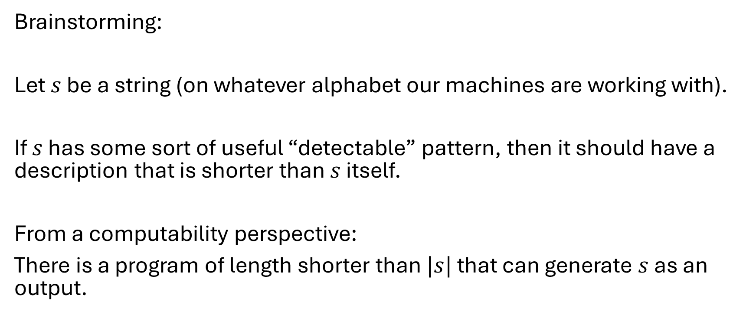
Activity 6 (Defining Randomness of a String)
Brainstorming:
Let $s$ be a string (on whatever alphabet our machines are working with).
If $s$ has some sort of useful “detectable” pattern, then it should have a description that is shorter than $s$ itself.
From a computability perspective:
There is a program of length shorter than $|s|$ that can generate $s$ as an output.

Slide 16
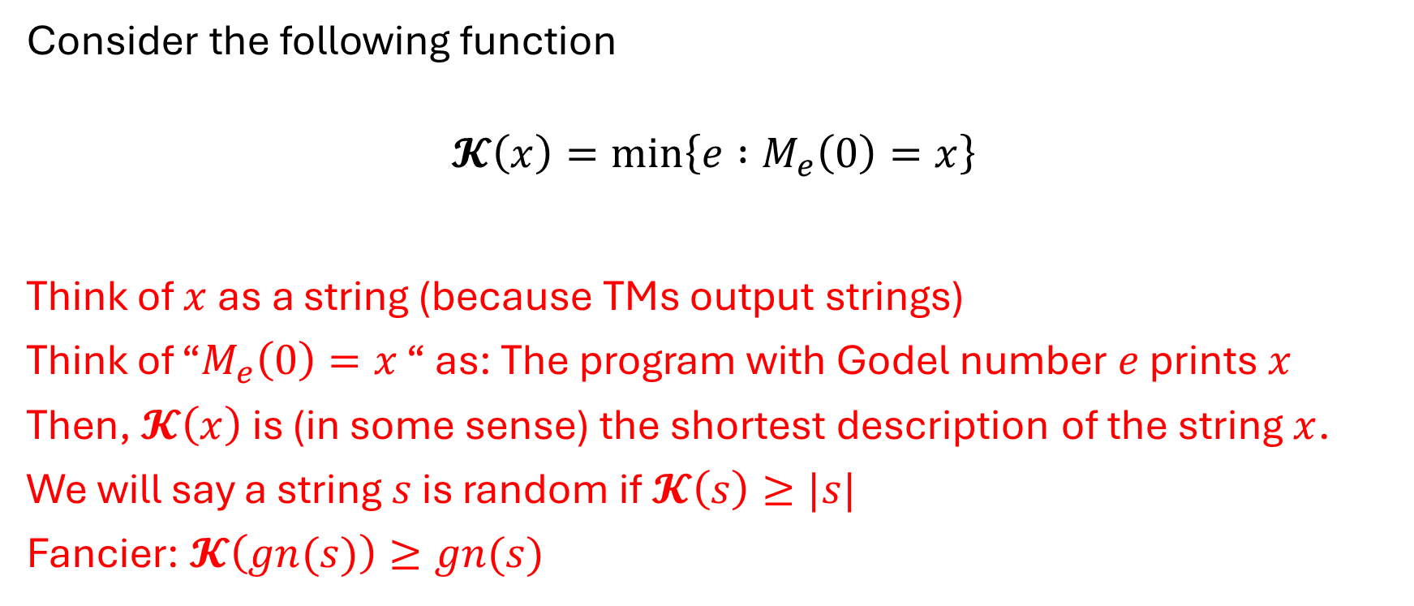
Activity 5 continued: Kolmogorov Complexity
Consider the following function
$$𝓚\left(x\right)=\min_{}\left\{e :M_{e}\left(0\right)=x\right\}$$
Think of $x$ as a string (because TMs output strings)
Think of “$M_{e}\left(0\right)=x$ “ as: The program with Godel number $e$ prints $x$
Then, $𝓚\left(x\right)$ is (in some sense) the shortest description of the string $x$.
We will say a string $s$ is random if $𝓚\left(s\right)≥|s|$
Fancier: $𝓚\left(gn(s)\right)≥gn(s)$
Notes:
Kolmogorov complexity We will say a string $s$ is random if $𝓚\left(gn(s)\right)≥gn(s)$

Slide 17
Example
x = 11111111111111111111111 …. 11111111111111111111111
Say 10^100 ones
It is easy to write a program of very few lines (has at most 100 characters) that prints x

Slide 18
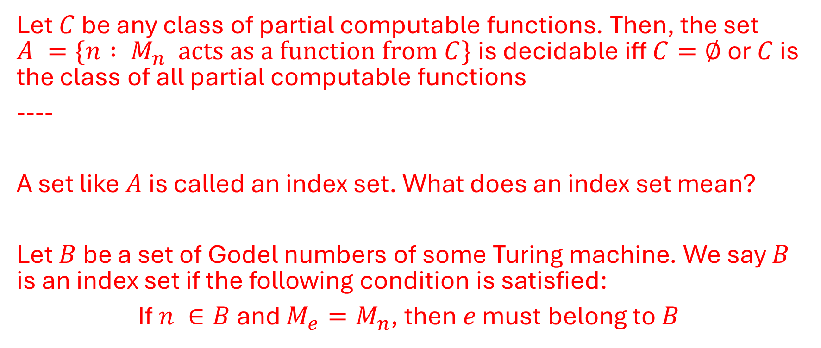
Rice’s theorem:
Let $C$ be any class of partial computable functions. Then, the set $A =\{n : M_{n} acts as a function from C\}$is decidable iff $C=∅$ or $C$ is the class of all partial computable functions
----
A set like $A$ is called an index set. What does an index set mean?
Let $B$ be a set of Godel numbers of some Turing machine. We say $B$ is an index set if the following condition is satisfied:
If $n ∈B$ and $M_{e}=M_{n}$, then$e$ must belong to $B$

Slide 19
Rice’s theorem is saying that:
an index set is decidable iff it is trivial
By trivial we mean ℕ or empty
i.e. corresponds to all Turing machines or none at all
Examples of interesting index sets (check the assignment): Tot, Fin

